Slide 1



Data ANALYSIS and INSIGHTS for different page Optimization & How to get more user install & Engagement from the App & Website

Slide 2

Tools used : Pandas seaborn MATPLOT

Slide 3

From the analysis what are the things we find & what are the things need improve let’s see.

Slide 4
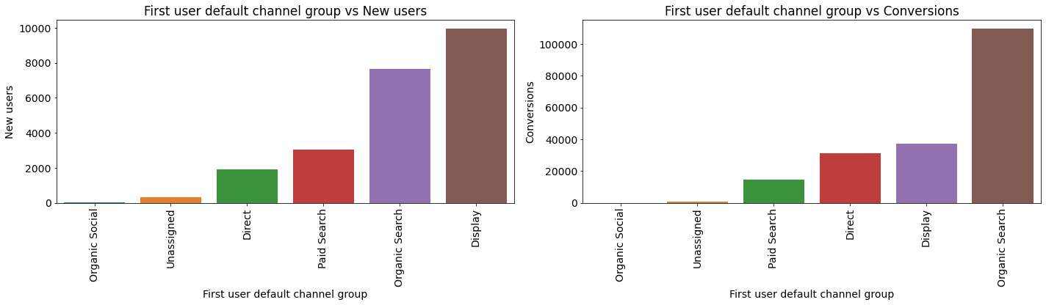
Organic search are widely used here

Slide 5
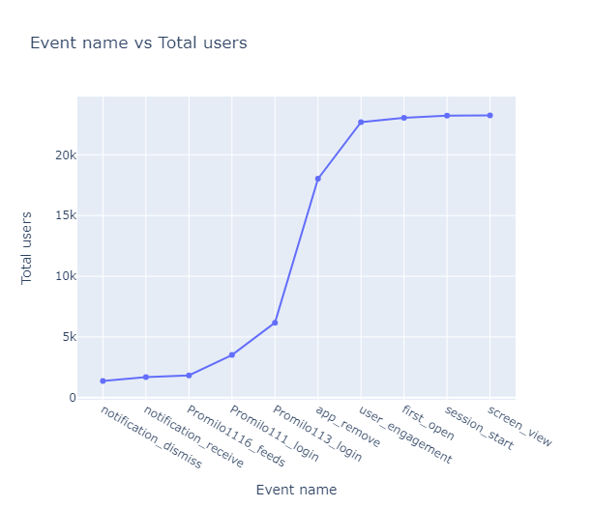
Screen view & session start are more consuming by the users

Slide 6
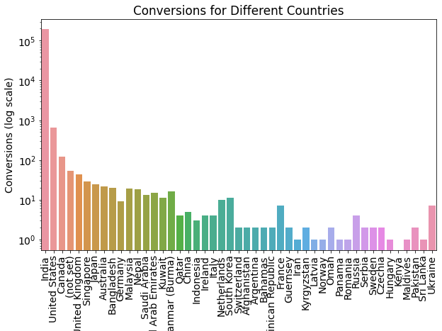
India is the highest rate of conversion, US & Canada are second & third highest.

Slide 7
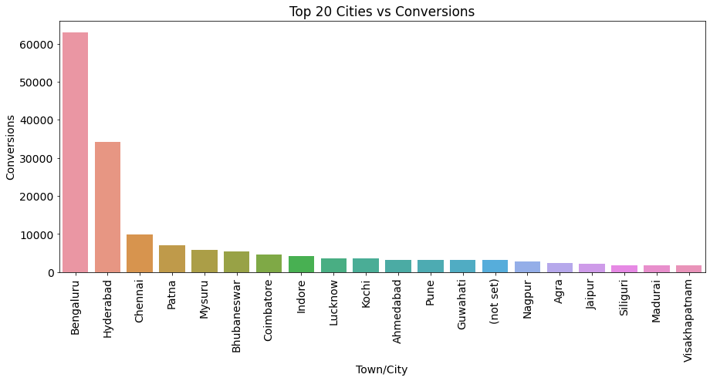
Bengaluru having most conversion rate in india. second is the Hyderabad.

Slide 8
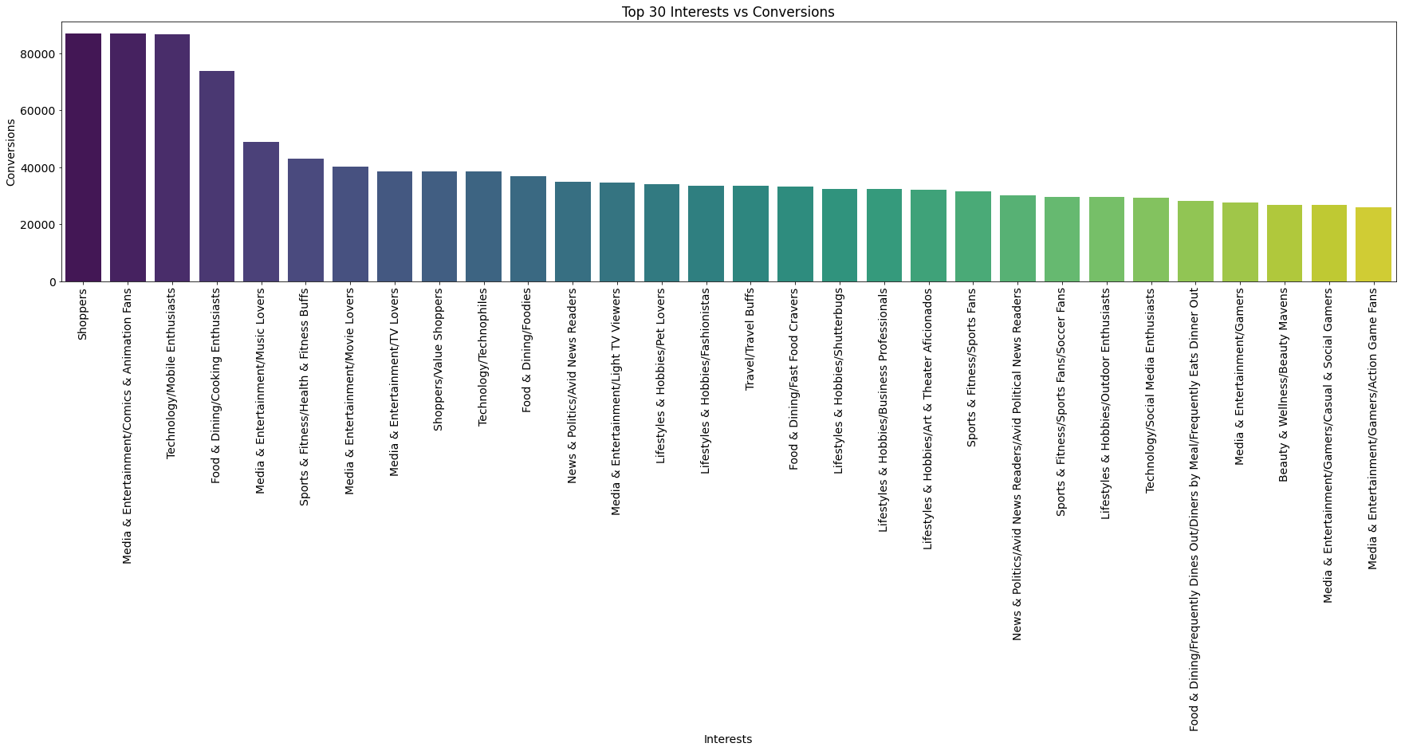
Top 30 category users by interest. Shopping is first media and entertainment is the second most interest topic

Slide 9
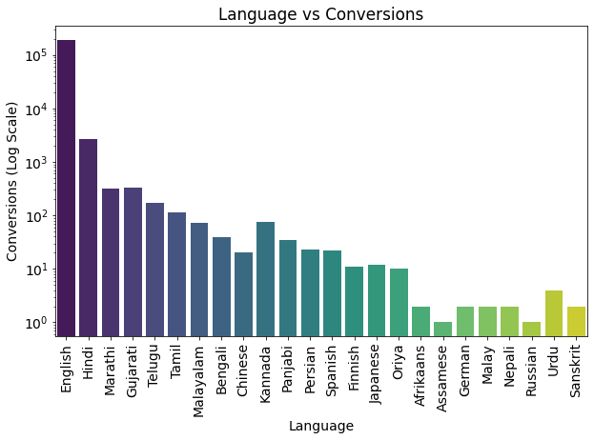
Language vs conversion.

Slide 10
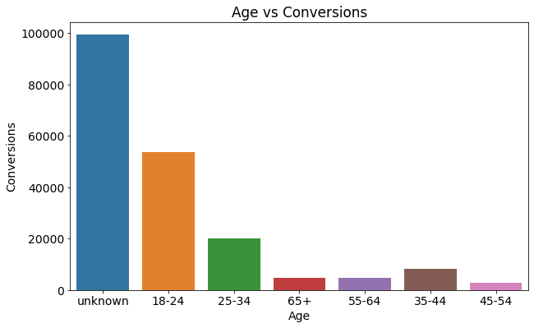
people hide their age, while log in. so its consider as a unknown. The unknown category are in higher conversion. 18-24 age people are second highest in conversion 45-54 age people are less when comes to conversion 65+ age people are heving less engagement time

Slide 11
IMPORTANT THINGS FROM THE ANALYSIS
1. In User Acquisition: Organic Search is the most important factor for user conversion.
2. In Traffic Acquisition: The Unassigned Category is crucial for conversions.
3. In Event Report: Screen Views, Session Starts, First Opens, and User Engagements occur more frequently during user usage.
4. In Conversion Report: Notifications play a vital role in conversions. When a customer sees a notification, it triggers user engagement.
5. In Page Path and Screen Class: If a conversion occurs, the Login Page appears more frequently. Login Flutter, Feeds, Storyboard, etc., are major components here.
6. In Demographics Report: India has the highest conversion rate, while Kenya, Panama, Maldives, Sri Lanka, and Romania have the lowest conversions.
7. In Citywise Report: Bengaluru has the highest conversion rate, followed by Hyderabad.

Slide 12
8. In Gender Report: Users often do not specify their gender during login, resulting in it being considered unknown. Additionally, males have a higher conversion rate.
9. In User by Interest: Users are interested in shopping, media entertainment, technology, and mobile usage.
10. In User by Language: Users primarily use English, followed by Hindi, which has the highest conversion rate.
11. In User by Age: People aged 18-24 have the second-highest conversion rate, while those aged 45-54 have lower conversion rates. Those aged 65+ have less engagement time.
12. In Google Ads Report: The cost per conversion is higher for April app installations. Despite the amount paid for Google Ads, the conversion rate is very low.

Slide 13
NEEDS TO IMPROVRE
1. Users are required to provide their correct age and gender during login; only then can we analyze which categories people interact with our products most.
2. In the Indian region, we need to focus on tier-2 and tier-3 cities.
3. In the 25-34 age category, the conversion rate is very low. Despite users being independent in that category, conversions are low. We need to focus more on that age group.
4. Vehicle, Food & Dining, Finance & Banking, Home & Garden, and Wellness are the least interesting to users. Perhaps we should focus on improving or discontinuing them.
5. We must be cautious about investing in Google Ads because the conversion rate is very low considering the money we allocate to the ads.

Slide 14
Kindly go through the entire data analysis
Click here
THANK YOU

